Slide 1
Bioinformatics Analysis on Carbonic Anhydrase(CA) samples from their amino acid sequences Rajarshi Ray, Ratul Bhowmik , Ajay Manaithiya , Dr. Ashok Aspatwar

Slide 2
What are Carbonic Anhydrase(CA) enzyme?
CAs are enzymes which are responsible for catalysing the interconversion between carbon dioxide and water and bicarbonates. The active site of most carbonic anhydrases contains a zinc ion. Carbonic anhydrase helps maintain acid–base homeostasis, regulate pH, and fluid balance. Depending on its location, the role of the enzyme changes slightly. For example, carbonic anhydrase produces acid in the stomach lining. In the kidney, the control of bicarbonate ions influences the water content of the cell. The control of bicarbonate ions also influences the water content in the eyes. Inhibitors of carbonic anhydrase are used to treat glaucoma, the excessive build-up of water in the eyes

Slide 3
Samples taken for the analysis
α-CA – Vertebrates – Bacterial (Base),Parasitic(Base)
β-Ca – Mtb (Base)
Mtb Rv1284 (β-CA1) : PDB IDs: 1YLK, 4YF4, 4YF5, 4YF6
Mtb Rv3588c (β-CA2 or CanB : PDB IDs: 1YM3, 2A5V.
Mtb Rv3273 (β-CA3) : No specific PDB ID is mentioned for the crystal structure. Instead, a homology model for the catalytic domain of Rv3273 is available in the SWISS-MODEL Repository, based on the template protein Can2 from Cryptococcus neoformans (PDB ID: 2W3N)
M. marinum (β-Ca) – Primary comparison with Mtb

Slide 4
Analysis performed till now
Physio-chemical property computation – Expasy ProtParam Server
Phosphorylation sites and kinase activity determination – NetPhos
Classification of biological activity determination – VICM server
Biochemical interaction determination(molecules or drugs) – STITCH
BLASTP and BLASTX on sequences for obtaining identities – BLAST
MSA and Phylogenetic analysis – MEGA11
Protein sample structure prediction and evaluating structural and biological functions using Ab initio and threading – iTASSER and COACH

Slide 5
Physio-chemical property computation – Expasy ProtParam Server
Property Name | Definition | Importance
Sample Name | A unique identifier assigned to a sample or entity in the context of the study. | Identification and tracking of specific samples/entities.
No. of Amino acids | The total count of amino acid residues in the protein sequence. | Overall size and length of the protein.
Total number of negatively charged residues (Asp + Glu) | The sum of aspartic acid (Asp) and glutamic acid (Glu) residues, which carry a negative charge at physiological pH. | Influence on protein charge and interaction with other molecules.
Total number of positively charged residues (Arg + Lys) | The sum of arginine (Arg) and lysine (Lys) residues, which carry a positive charge at physiological pH. | Influence on protein charge and interaction with other molecules.
Molecular weight | The mass of the protein molecule, expressed in daltons (Da) or atomic mass units (AMU). | Provides information about the protein's mass.
Theoretical PI | The isoelectric point (pI) is the pH at which a protein carries no net electrical charge. | Important for protein separation and purification techniques.
Instability index | A measure indicating the stability of a protein; higher values suggest greater instability. | Indicates the protein's susceptibility to unfolding or degradation.
Aliphatic index | A measure of the relative volume occupied by aliphatic side chains (e.g., Ala, Val, Ile, Leu) in a protein. | Reflects the protein's hydrophobicity and structural stability.
Total number of atoms | The sum of all atoms in the protein structure. | Provides information about the complexity of the protein structure.
Grand average of hydropathicity (GRAVY) | A measure of the overall hydrophobicity or hydrophilicity of a protein sequence. Higher GRAVY values suggest hydrophobicity. | Influences the protein's interaction with water and membranes.

Slide 6
Phosphorylation sites and kinase activity determination: NetPhos
From the results of phosphorylation we can see various kinases and ability to phosphorylate . This can denote that post translational modifications and from graphs Higher peaks suggest potential phosphorylation sites. These regions might be functionally important, as phosphorylation is a common post-translational modification that regulates various cellular processes, including signal transduction, protein-protein interactions, and enzymatic activities. Hence we can discuss and conclude that higher kinase activity and phosphorylation can conclude that the protein can participate in various biological processes and functions which are exactly what is needed for drug development and ADMET as we want the maximum metabolism levels and Distribution which is possible through cellular localisations only.

Slide 7
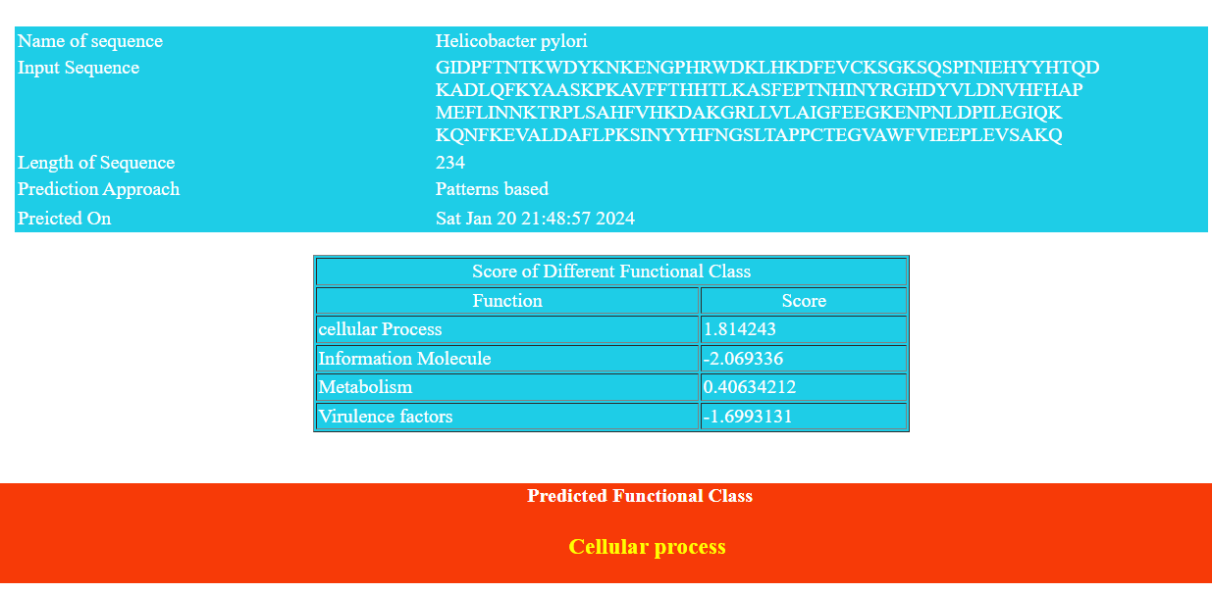
Classification of biological activity determination – VICM server
Analyses the amino acid sequence of samples and determines in which biological category does the protein sample fall into.Example outputs shown below:

Slide 8
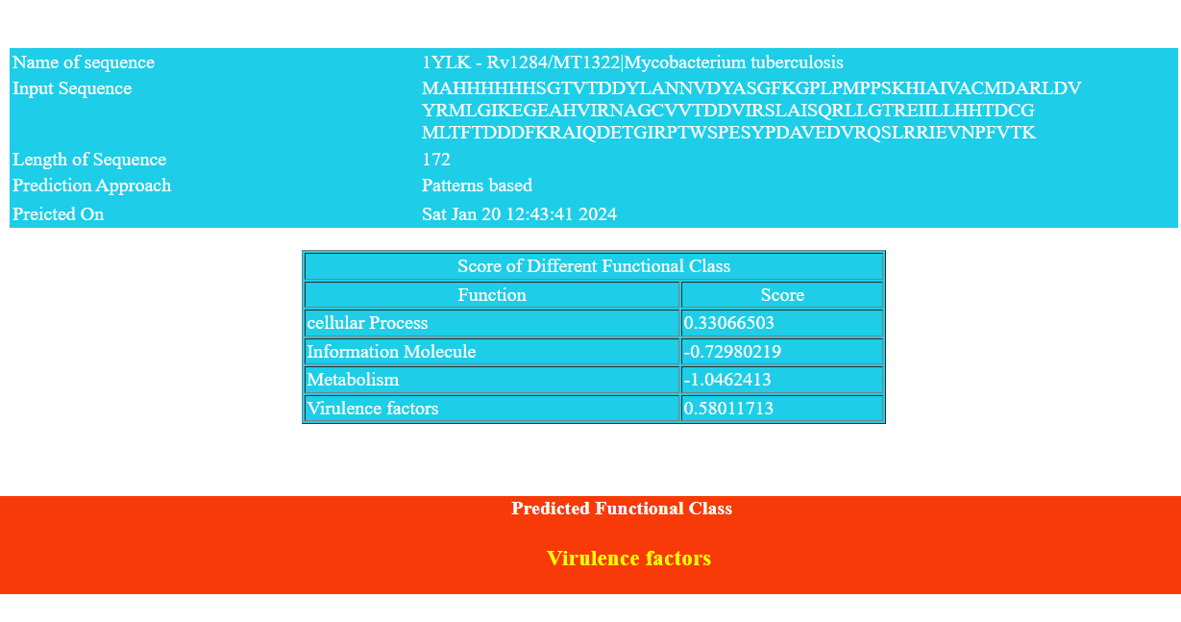

Slide 9
Biochemical interaction determination(molecules or drugs) – STITCH
This server analyses the amino acid sequence of the samples and determines all kinds of molecular interactions and chemical interactions by taking information from all databases and compiling together to create a tree based graph where the parent node is the query organism and the children leaf nodes are the chemicals or molecules which interacts with them.These molecules can be drugs which are associated with bioactivities (activation or inhibition) for protein functions or cofactors which are essential for overall functioning of proteins like transmembrane properties,transportation or localisation properties.

Slide 10
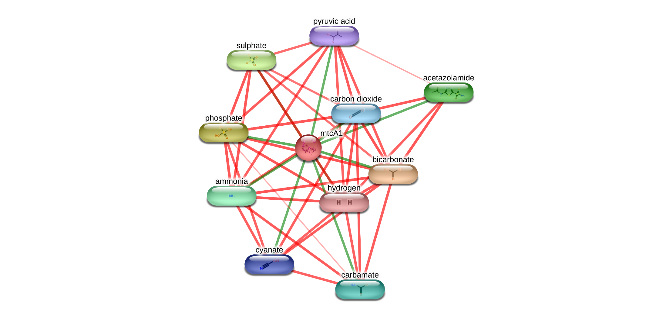
Mtb Rv1284 (β-CA1) : RCSB PDB - 1YLK: mtcA1 (Mycobacterium tuberculosis H37Rv) - STITCH network view (embl.de)

Slide 11
BLAST,MSA & Phylogenetics
Considering Beta CA and Gamma CA from Mycobacterium species as initial analysis. We obtain a base sequence from each category and run BLASTP on them to obtain results which are biologically similar to the query.Setting the identity percent between 97 – 99.9% we obtain the sequences and perform MSA using MEGA11 software and construct a phylogenetic tree to evaluate the evolutionary connection among the species.Using neighbor joining tree with bootstrap scores gives us an important insight into understanding evolutionary distance among the species to understand the evolutionary connections among the species.

Slide 12
I-TASSER and COACH
This is a Ab initio modelling server which utilises threading techniques to predict the molecular structure of a query amino acid sequence along with its biological properties like Secondary structure prediction, Solvent Accessibility, Predicted normalized B-factor and structures generated from modelling techniques. Moreover integrated results from COACH server determines the ligands involving cofactors and molecules which interact with the query and the identity hit compounds along with their proper coordinates positions and residues where they bind. These gives an idea for drug development and molecular docking processes which is integral during drug designing for CA inhibition use cases. Metabolic pathway and ontological information is also provided which can be included for pathway enrichment analysis methodologies.
Example for Neoformans CA3 sequence : I-TASSER results (zhanggroup.org)

Slide 13
Seq Eclipse App
Using Python web development library : Streamlit we built an web server for assembling all the mentioned analysis into a single place.
Combining the functionality of python based biological analysis library like Biopython and API from STRING and ESM Fold servers we developed an application to compute and predict overall physico-chemical properties and structural information for query proteins through ab initio modelling techniques in a user friendly manner.

Slide 14


